Slide 1
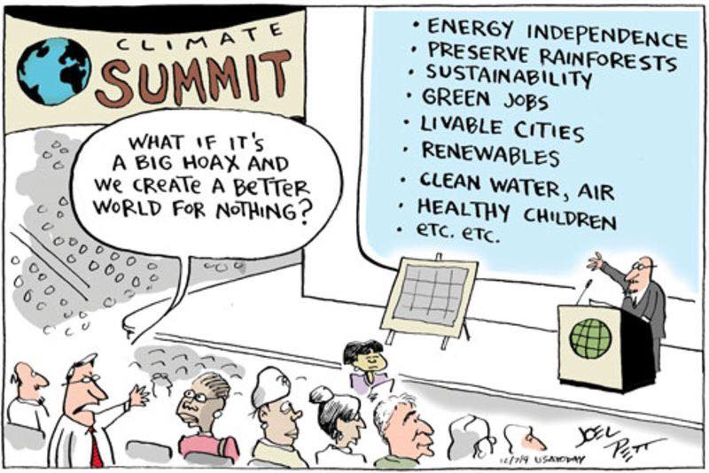
Systems: Stocks, Flows,
& Feedbacks
Goals:
Define stock, flow, and feedback
Explain how the combined history of inflows and outflows determines a stock
Predict what happens to stocks and flows when a system is perturbed
Construct examples of both amplifying and stabilizing feedbacks.
Notes:
Fall 2012: THE WORKSHEET TAKES MORE THAN 45 MINUTES
Fall 2013: The worksheet took about 35 minutes, then the last 10 minutes for debriefing it. We didn’t get to the feedbacks and examples.
Fall 2014: Had 7 minutes for the feedbacks. Lost track of time and didn’t debrief that activity.

Slide 2
Climate news
Hurricane Dorian stalls over the Bahamas
Here’s what the original research looks like:
Hall and Kossin – 2019
Fires in Australia

Slide 3
Question: Why don’t we put the answers to the clicker questions up on canvas?

Slide 4
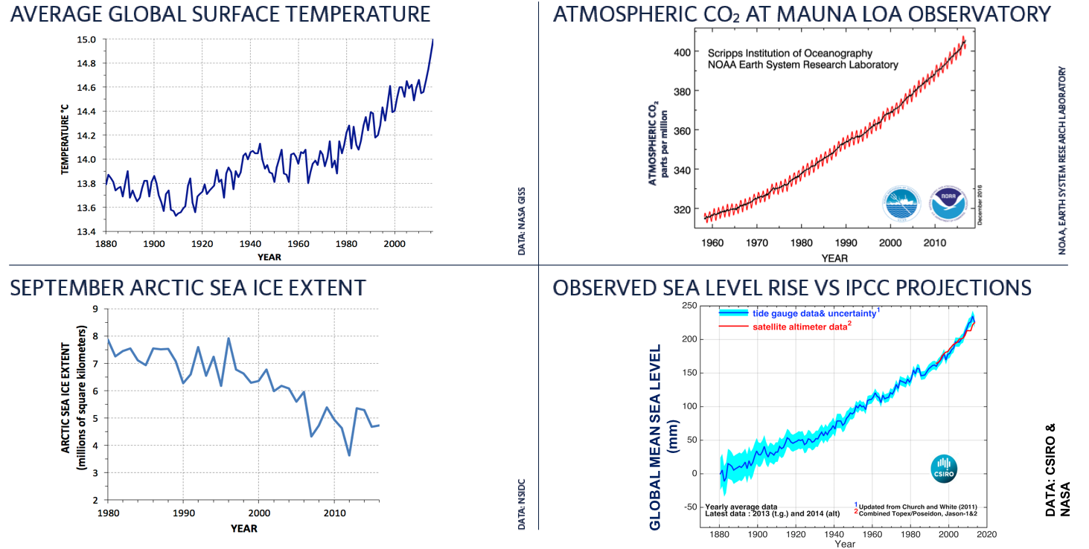
Worksheets from Day 1: Sea ice
Stories: Attempts to connect these different data through various processes. Common story: “CO2 causes T to rise, which causes sea ice to melt, which causes sea level to rise” [one problematic link…]
Notes:
LETS DISCUSS THESE IN TERMS OF SYSTEM DYNAMICS: STOCKS AND FLOWS CHANGING OVER TIME
TEMPERATURE → STOCK AND FLOWS OF ENERGY. IMBALANCE IN ENERGY FLOWS → CHANGING STOCK (TEMP)
CO2 → IMBALANCE OF INFLOW AND OUTFLOW
SEA ICE → STOCK DETERMINED BY ICE FORMATION (INFLOW) AND MELTING (OUTFLOW)
SEA LEVEL → STOCK OF WATER DETERMINED BY WATER LEAVING OR FLOWING INTO THE OCEAN…
(VOLUME OF SEA WATER IS ALSO DETERMINED BY TEMP. AND SALINITY).
Discuss that each of these is a product of system dynamics. Stocks and flows changing over time.
Temperate: stocks and flows of energy, imbalance in energy flows leads to changing stock and changing temperature
CO2 – imbalance of inflow and outflow over time
Sea ice – a stock determined by ice formation (inflow) and melting (outflow)
Sea level – the stock of water is determined by water molecules leaving the ocean or flowing into the ocean. The volume that the water occupies is also a function of physical characteristics, like temperature and salinity.

Slide 5
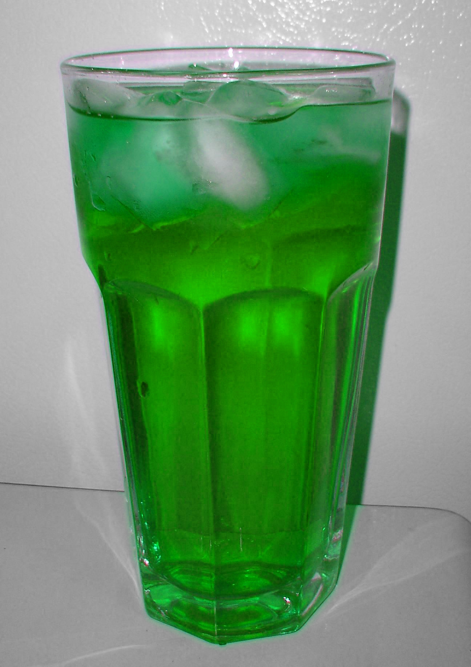
Questions/Comments: Worksheet
1. Sea ice versus land ice – impact on sea level
Once this ice melts in this glass, how will the water level be different? Water level will be ______before.
http://commons.wikimedia.org/wiki/File:Menthaleau.jpg
higher than
lower than
the same as
Notes:
If you can write us an email explaining an alternate answer to question 7 on the quiz (the one about sea ice, land ice, and sea level rise), we’ll give you credit. There’s at least one person who alluded to a small subtlety in the comments. Send us an email by midnight tonight.
SH took off these three text boxes from previous term
2. Arctic versus Antarctic: What’s the difference?
3. Temperature anomalies: See lucid explanation at
http://www.skepticalscience.com/OfAveragesAndAnomalies_pt_1A.html
4. “Does amplifying feedback always result in a negative outcome?”

Slide 6
More on buoyancy
Suppose that ice was 70% as dense as water. If you froze a block of liquid water, how much of the volume would be above the surface? A) 10% B) 30% C) 50%
D) 70% E) 90%

Slide 7
Questions/Comments: Pre-Class Quiz
Stoichiometry practice
Say we have 100 gigatons of H₂O.
How many gigatons of O is contained within that 100 Gton H₂O?
2
89
98
100
102
Quiz question involved the mass of C in CO₂.
You will need to be able to go back and forth between mass of C and mass of CO₂ in this course.
Notes:
ANSWER = B
16/18 = 0.888
81% of you got this question right on the quiz
Do individually
Answer: B
16/18 = 0.888

Slide 8
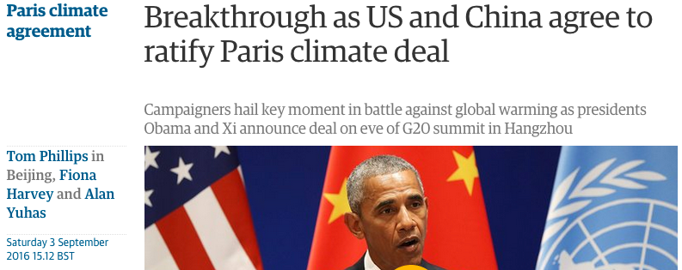
Caldeira, 2012- Pre class reading
“One of the greatest uncertainties in climate prediction is the amount of CO₂ that will ultimately end up in the atmosphere”
Some text from the Dec 2015 Paris agreement:
Emphasizing with serious concern the urgent need to address the significant gap between the aggregate effect of Parties’ mitigation pledges in terms of global annual emissions of greenhouse gases by 2020 and aggregate emission pathways consistent with holding the increase in the global average temperature to well below 2 °C above pre-industrial levels and pursuing efforts to limit the temperature increase to 1.5 °C,
Notes:
91% of you got this quiz question right.

Slide 9
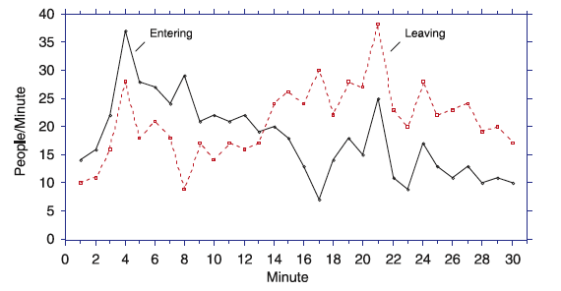
We’ll work with this plot during class. See post-class slides for more.
Figure: Cronin & Gonzalez, 2007
Notes:
PUT THIS IN PRE_CLASS SET

Slide 10
Clicker Q: The graph below shows the numbers of people entering and leaving a store each minute. During which minute did the most people enter the store?
Minute 4
Minute 8
Minute 13
Minute 21
Cannot be determined
Figure: Cronin & Gonzalez, 2007
Notes:
THE COMBINED HISTORY OF INFLOWS AND OUTFLOWS DETERMINES A STOCK
ANSWER = A
LG: Explain how the combined history of inflows and outflows determines a stock
ON to stock and flow (fairly abrupt transition here):
Try doing this series of clicker questions BEFORE the “Stock & Flow” slides. See what people do. Then do a couple of explanatory slides about stock and flow, then the worksheet.
ANSWER: A
Figure from Cronin, M. A., & Gonzalez, C. (2007). Understanding the building blocks of dynamic systems. System Dynamics Review, 23(1), 1–17. doi:10.1002/sdr.356
This journal explicitly allows (“permitted use”) info to be posted on learning management systems!

Slide 11
Clicker Q: The graph below shows the numbers of people entering and leaving a store each minute. During which minute did the most people leave the store?
Minute 4
Minute 8
Minute 17
Minute 21
Cannot be determined
Figure: Cronin & Gonzalez, 2007
Notes:
ANSWER = D
LG: Explain how the combined history of inflows and outflows determines a stock
ANSWER: D
Figure from Cronin, M. A., & Gonzalez, C. (2007). Understanding the building blocks of dynamic systems. System Dynamics Review, 23(1), 1–17. doi:10.1002/sdr.356
This journal explicitly allows (“permitted use”) info to be posted on learning management systems!

Slide 12
Clicker Q: The graph below shows the numbers of people entering and leaving a store each minute. During which minute were the MOST people in the store?
Minute 4
Minute 8
Minute 13
Minute 17
Cannot be determined
Figure: Cronin & Gonzalez, 2007
Notes:
ANSWER = C
AFTER 13 MINUTES, MORE PEOPLE START LEAVING THE APPLE STORE
Would be useful to have a doc cam for explaining this – we had a lot of discussion about why it is not minute 8 – used a Las Vegas analogy: if I start with $2 and I win $13m in first minute and lose $10m how much does my account have in it at end of min 1, then at end of min 2 etc.
LG: Explain how the combined history of inflows and outflows determines a stock
ANSWER: C
Figure from Cronin, M. A., & Gonzalez, C. (2007). Understanding the building blocks of dynamic systems. System Dynamics Review, 23(1), 1–17. doi:10.1002/sdr.356
This journal explicitly allows info to be posted on learning management systems (“permitted use”)!
The answer choices selected are based on Table 1 in Cronin, M., Gonzalez, C., & Sterman, J. (2009). Why don’t well-educated adults understand accumulation? A challenge to researchers, educators, and citizens. Organizational Behavior and Human Decision Processes, 108(1), 116–130. doi:10.1016/j.obhdp.2008.03.003

Slide 13
Clicker Q: The graph below shows the numbers of people entering and leaving a store each minute. During which minute were the FEWEST people in the store?
Minute 1
Minute 13
Minute 17
Minute 30
Cannot be determined
Figure: Cronin & Gonzalez, 2007
Notes:
ANSWER D
TIME WHEN MOST PEOPLE HAVE LEFT
LG: Explain how the combined history of inflows and outflows determines a stock
ANSWER: D
Figure from Cronin, M. A., & Gonzalez, C. (2007). Understanding the building blocks of dynamic systems. System Dynamics Review, 23(1), 1–17. doi:10.1002/sdr.356
This journal explicitly allows info to be posted on learning management systems (“permitted use”)!
The answer choices selected are based on Table 1 in Cronin, M., Gonzalez, C., & Sterman, J. (2009). Why don’t well-educated adults understand accumulation? A challenge to researchers, educators, and citizens. Organizational Behavior and Human Decision Processes, 108(1), 116–130. doi:10.1016/j.obhdp.2008.03.003

Slide 14
Systems dynamics: Stock & Flow
STOCK: Amount or quantity of something residing in a particular place at a particular time
apples in a basket, water in a glacier, fish in the sea, knowledge in your brain…
FLOW: The rate at which stuff adds or subtracts from a stock. Since flow is a RATE, there is always an element of TIME included.
apples picked per hour, water melted per month, fish born per year,
knowledge GAINED PER 90MIN EOSC340 CLASS
INFLOW: The rate at which stuff flows IN.
OUTFLOW: The rate at which stuff flows OUT.
Inflow
STOCK
Outflow
The STOCK, at any moment, is the result of the COMBINED HISTORY of INFLOW and OUTFLOW
Notes:
FALL 2013 – did not talk about this. Just said “you all have read about this, so I’m not going to talk about it”
LGs: Define stock, flow, and feedback
Explain how the combined history of inflows and outflows determines a stock
Link to previous clicker Q sequence.

Slide 15
Systems dynamics: Stock & Flow
The RATE AT WHICH THE STOCK CHANGES, is the difference between the INFLOW & the OUTFLOW
If Flow_{in} = Flow_{out}
no change in stock over time
→ EQUILIBRIUM
If Flow_{in} ≠ Flow_{out} → stock will change over time
Notes:
Fall 2013 – did very briefly – said, again, that they’d read about it already, and it’s going to be relevant for the worksheet.
LG: Explain how the combined history of inflows and outflows determines a stock
Predict what happens to stocks and flows when a system is perturbed
If you have in inflow rate of 3 apples per minute and an outflow rate of 1 apple per minute, your stock will change by +2 apples per minute.

Slide 16
Stock & Flow Worksheet
Work in pairs or 3s. Once you have a pair or a 3, raise your hands and we’ll get you a worksheet
Notes:
Jordan’s worksheet, using Q1, modified 2, modified 3 (still need to modify)

Slide 17
Worksheet PROBLEM 1 clicker:
Notes:
ANSWER: B
Bring blank worksheet for doc cam. Go through answer, drawing on the paper on the doc cam.

Slide 18
Worksheet PROBLEM 2 clicker:
Worksheet problem 2:
At what minute are inflow and outflow equal?
0
1
2
Notes:
ANSWER: B
Fall 2014: Did a second on-the-fly clicker question: At what minute are inflow and outflow equal? A. 0 B. 1 C. 2 Got a split between B and C, then did it again and got mostly B (good).

Slide 19
Worksheet PROBLEM 2 clicker:
Notes:
ANSWER: C (ALSO SHOW NEXT SLIDE)
They might have created a sine curve, but the phase of neither A nor D is appropriate.
[series of parabolas]
Warn the students before this clicker question that there are a couple of viable lines they might have drawn. Only one of the choices in the clicker question is viable though. When choosing, they should choose the one that best follows the pattern of highs and lows that they generated.

Slide 20
Worksheet PROBLEM 2 clicker:
Notes:
ANSWER = C
Alternate answer choices turning the right answer (C) into a curve rather than straight lines. Made A have straight lines, same phase as before.
ANSWER: C
They might have created a sine curve, but the phase of neither A nor D is appropriate.
[series of parabolas]
Warn the students before this clicker question that there are a couple of viable lines they might have drawn. Only one of the choices in the clicker question is viable though. When choosing, they should choose the one that best follows the pattern of highs and lows that they generated.

Slide 21
Worksheet PROBLEM 3 clicker:
Notes:
Fall 2013 – I accidentally went through an explanation of this on the doc cam, before showing them the clicker question.
ANSWER: C

Slide 22
Summary
Earth’s climate system is essentially a whole bunch of interconnected stocks, flows, and feedbacks.
The combination of inflows and outflows over time determines a stock.
Both stocks and flows can be perturbed. When a perturbation happens, the system responds.
Perturbations in stocks can influence flows, which in turn can influence stocks again.
Perturbations in flows can influence stocks, which in turn can influence flows again.
4. Amplifying feedbacks destabilize a system by reinforcing perturbations. Stabilizing feedbacks counteract perturbations and help move a system toward a stable state.

